Slide 1
EPA Brownfields Coalition Assessment Grant
COMMUNITY MEETING Wed., Jan. 27 – 6 to 8 PM

Slide 2
WELCOME & INTRODUCTIONS HLA
County Commissioners
City Council Members
Pershing County Economic Development Association Lisa Hanusiak, EPA Region 9 David Friedman, NDEP
Brownfields Team
Heidi, Sheryl, Lisa, David, Philip, Tom, Don

Slide 3
Welcome - Comments
MAYOR MICHAEL GILES

Slide 4
WORKSHOP PURPOSE HLA
Overview of the EPA Brownfields Program & Our Grant
Benefits of the Brownfields Program
Activities/Tasks associated with Coalition Assessment Grant
Greater understanding of the Phase I and Phase II Activities
Certified Sites
Meet the Brownfields Team & Their Expertise
Similar Successful Brownfields Projects
Questions answered

Slide 5
Brownfields Project Manager U.S. Environmental Protection Agency, Region 9
LISA HANUSIAK

Slide 6
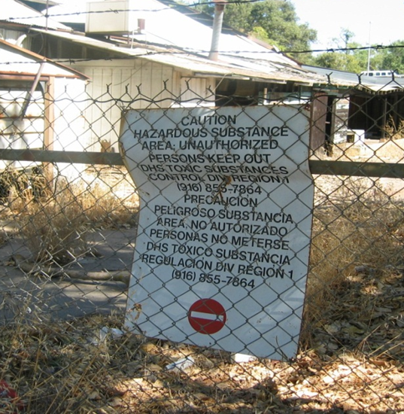
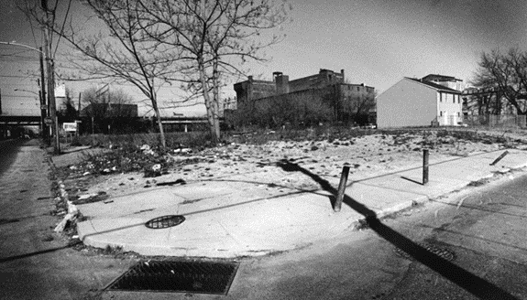
What Are “Brownfields”?
Real property, the expansion, redevelopment, or reuse of which may be complicated by the presence or potential presence of a hazardous substance, pollutant, or contaminant
Often in a designated redevelopment area and part of an overall planned strategy to revitalize and breathe new life into the community

Slide 7
Brownfields Revitalization Program
Designed to provide funding to help communities address public and privately-owned properties that are planned for redevelopment including:
Sites that are contaminated
There is a perception that the property is contaminated
Typical sites include:
Abandoned buildings
Vacant lots
Old gas stations
Under-utilized properties
Dry cleaners

Slide 8
Phillip Childers Tom Mix
THE CONVERSE TEAM

Slide 9
Ways That Coalition Partners Can Benefit from Brownfields Redevelopment Funding
Conserve resources that would otherwise be needed to clear Publicly Owned property for redevelopment
Funding can be used to assess private sites to speed overall revitalization
Attract New Businesses and Jobs
Increase Property and Sales Tax Revenues
Prepare for future economic upturn
Improve Public Health and the Environment

Slide 10
City of Lovelock and Pershing County Use of EPA Brownfield Funding
Inventory, Screen and Prioritize Redevelopment properties for environmental assessments;
Conduct Phase I and Phase II ESA’s
Develop Cleanup Plans for contaminated properties, if needed;
Develop Site Reuse Plans, Certified Sites; and,
Conduct and Stakeholder Outreach Participation

Slide 11
WNDD, City of Lovelock & Pershing County Brownfields Coalition Work Plan
Inventory of potential sites
Screening and ranking of candidate Brownfields sites
21 Phase I ESAs
12 Phase II ESAs
8 Cleanup and 4 Reuse strategies
Community Engagement
Project and Grant Management

Slide 12
Why Do a Phase I ?
Bank will require a Phase I before providing funding
If you buy/transfer a property without a Phase I, you buy the entire property. The good, bad, and ugly. If it turns out to have contamination its 100% your problem
Doing a Phase I affords the following Limited Liability Protection under federal law:
Innocent Landowner Defense
Contiguous Property Owner Defense
The Bona Fide Prospective Purchaser Defense

Slide 13
What is a Phase II & When Is It Needed ?
Recognized Environmental Condition (REC) or Environmental Risk is identified in the Phase I Report that requires physical investigation onsite. May identify contamination that will require further characterization and cleanup.
Include sub-surface soil analysis, groundwater sampling, installing monitoring wells, indoor air sampling, mold sampling, asbestos sampling, lead sampling etc..
A Phase II Assessment must meet All Appropriate Inquires per ASTM standard.

Slide 14
New Brownfields Initiative: Certified Site Characterization
A Certified Site designation serves as a pre-qualification, indicating that a property’s title is clear, that it possesses, among other things, sufficient utilities and other infrastructure for commercial use, provides preliminary soil engineering, environmental due diligence and that it is properly zoned and has adequate transportation access for such uses.
Reduces the risk associated with development by providing detailed and current information about a site including price and availability, utilities, access, environmental concerns, and potential site development challenges.

Slide 15
Converse Consultants: Brownfields Experience
1992-Present
Prime Consultant Under 21 EPA Brownfields Grants
including 15 in Northern Nevada:
Churchill County
Lyon County
Mineral County
Carson City
Douglas County
Sparks
Carlin
City of Lovelock and Pershing County
We’re About Getting the Job Done Right. The First Time. Under-Budget. Ahead of Schedule

Slide 16
Our Coalition and Community-Wide Site Assessments and Targeted Brownfields Assessments Experience

Slide 17
Our Current Community-Wide Site Assessments Grant Projects

Slide 18
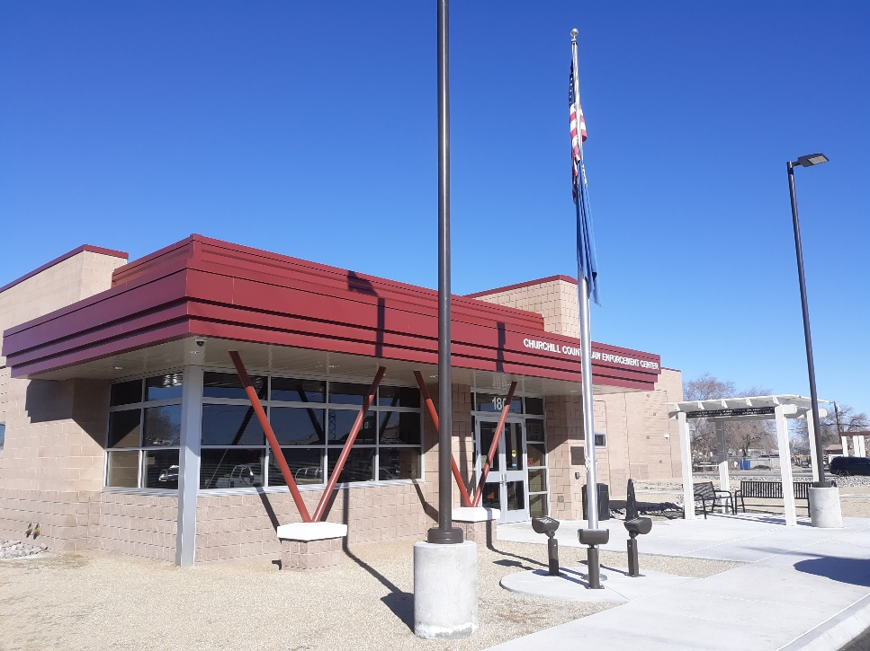
Successful Brownfields Revitalization Projects: Churchill County Law Enforcement Center

Slide 19
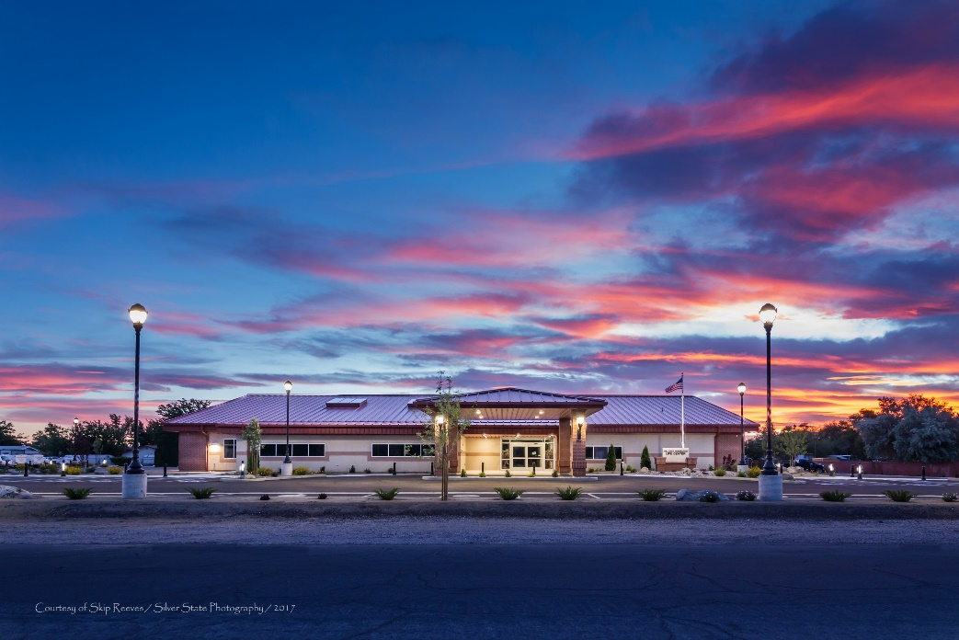
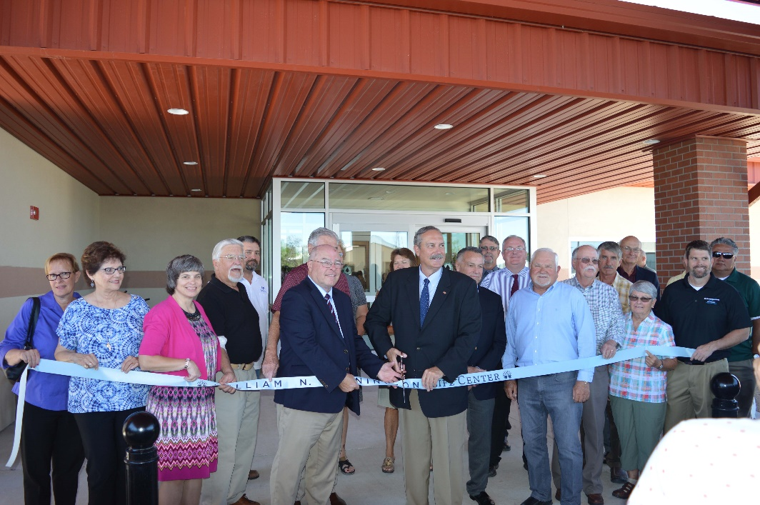
Successful Brownfields Revitalization Projects: William N. Pennington Life Center

Slide 20
Successful Brownfields Revitalization Projects: Polaris Distribution Center Fernley

Slide 21
questions

Slide 22
Contacts
For additional information, please contact:
Heidi Lusby-Angvick, Executive Director – PCEDA
775-273-4909 pceda.hlusby@gmail.com
Sheryl Gonzales, Executive Director – WNDD
775-473-6753 sgonzales@wndd.org
Philip Childers, Senior Environmental Manager, Reno, NV
775-856-3833
Pchilders@converseconsultants.com
Thomas A. Mix, National Brownfields Program Director
707-206-1647
tmix@converseconsultants.com

